Slide 1
FAKE NEWS DETECTION USING MACHINE LEARNING

Slide 2
What is fake news?
It is untrue information presented as news.
Often aims to damage reputation of a person or entity, or personal gains.
Provides false information, but makes it seem true.
Different from content on satirical sites like ‘The Onion’.
Usually spread through social media sites like Facebook, twitter, etc.

Slide 3
Why is detection of fake news important?
There are many sources of news in today’s era, thanks to the internet.
Not all the news sources can be trusted.
Fake news can cause severe damage if introduced at the right time.
Ex – fake news related to Covid-19.
It is treated as a threat to democracy, journalism and freedom of speech.
Through early detection, loss of property and even life can be prevented.

Slide 4
Problem Statement
FAKE NEWS DETECTION USING MACHINE LEARNING
We will use following machine learning algorithms to build fake news detectors:
Logistic Regression
Naïve-Bayes
Random forest
Stochastic gradient descent
Support vector machine
The model which provides best accuracy will be selected as the final model.
Language used is python and its libraries.

Slide 5
Hardware and Software Requirement
We are using following python libraries:
Beautifulsoup4,bs4,certify,Chardetcycler,idna,kiwisolver,Matplotlib numpy,pandas,Pillow,pyparsing,python-dateutil,pytz,Requests scipy ,seaborn ,Six, soupsieve ,urllib3,Tkinter
Support All The Hardware

Slide 6
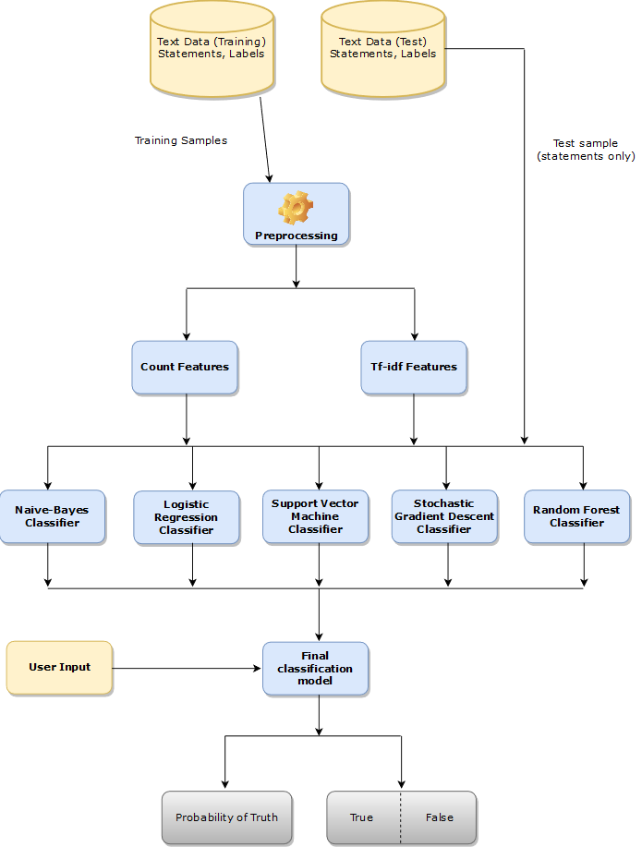
Process Flow of Project

Slide 7
Problems Faced
Liar Dataset majorly covers news about USA and also prevalence of missing speaker jobs and affiliations, which means that these features may not have been very useful for determining which piece of news was fake.
Kaggle Fake news Dataset covers very news topics releated to india.
To solve these problem we use crawler to collect data and create our own dataset.

Slide 8
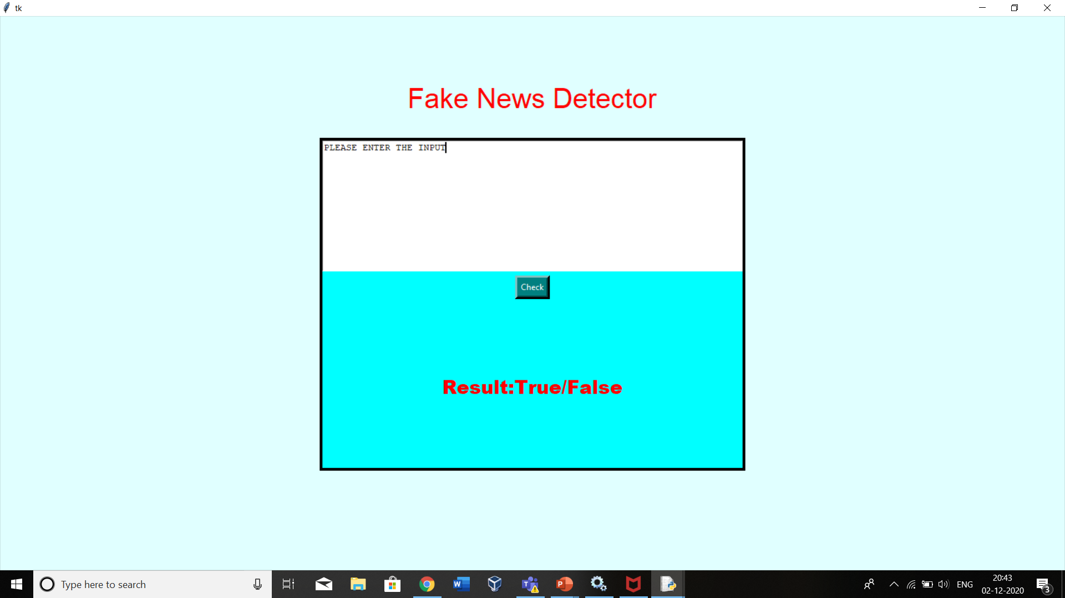
Work done Till now
UI is developed and designed using Tkinter
Code Url: https://github.com/shubhamjoshishiv/FakeNews/blob/main/FrontEnd/front-end.py

Slide 9
Data is collected from various sites and dataset is developed

Slide 10
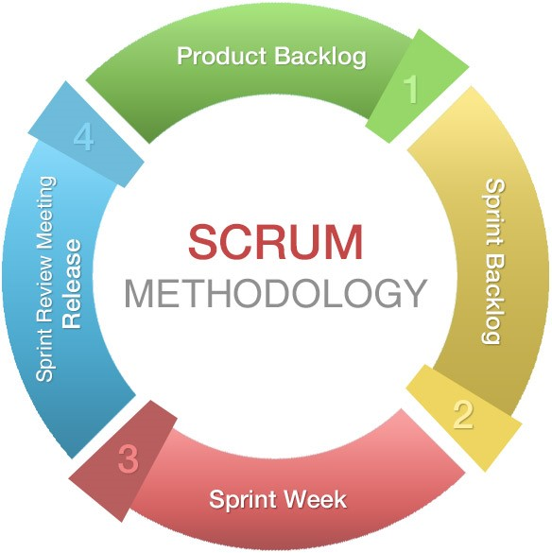
Project Management-SCRUM

